Slide 1


Introduction to
Robotic Process Automation
Title of the Project
220701105
Jayen Senthilkumar
Guide Name
Student of CSE department

Slide 2
Abstract
The Shipping Cost Calculation Automation Project leverages UiPath to automate the process of obtaining shipping quotes from courier websites like UPS. It collects user inputs for shipping details, including sender and recipient addresses, package weight, and dimensions, and inputs this data into the courier’s online form. The automation retrieves the calculated shipping cost and displays it directly to the user in a message box. By eliminating manual effort and reducing errors, this project ensures quick and accurate shipping cost estimation, showcasing the effectiveness of robotic process automation in streamlining logistics tasks.

Slide 3
Need for the Proposed System
The proposed Shipping Cost Calculator addresses the challenges associated with manually calculating shipping costs, which often involve repetitive data entry, potential errors, and time-consuming processes. In traditional methods, users must input shipping details multiple times, navigate through complex courier websites, and manually note the results, which can lead to inefficiencies and inaccuracies.
The system automates these tasks by leveraging UiPath to streamline the process. Users can simply input shipping details, and the system automatically interacts with the courier website (e.g., UPS) to fetch and display the shipping quote in real time. This reduces the workload, ensures data accuracy, and saves significant time.
The need for such a system arises from the growing demand for faster and more reliable logistics solutions, especially in industries like e-commerce, manufacturing, and retail. Automating shipping cost calculations enhances operational efficiency, minimizes errors, and provides a scalable solution for businesses and individuals managing frequent shipping operations. The proposed system simplifies this critical process, making it more accessible and user-friendly.

Slide 4
Advantages of the Proposed System
Error Reduction:
By automating data entry and extraction, the system minimizes the risk of human errors, ensuring more accurate and reliable shipping cost calculations.
Real-Time Results:
The shipping quote is retrieved and displayed instantly, providing users with quick and actionable information.
Consistency:
The system ensures consistent performance and results regardless of the frequency of usage, making it ideal for repetitive tasks.
Scalability:
The automation can be expanded to include multiple courier websites, additional input parameters, or integrated reporting functionalities.
Reduced Manual Effort:
By automating repetitive tasks, the system reduces the workload for users, allowing them to focus on other critical operations.
Improved Productivity:
Automating shipping cost calculations allows businesses to handle more requests in less time, improving overall productivity.

Slide 5
Literature Survey
Paper 1: "Robotic Process Automation in Logistics: Enhancing Efficiency and Accuracy"
Advantages:
  Demonstrates how RPA can streamline repetitive tasks, such as data entry and extraction.
  Reduces human error by automating calculations and interactions with web interfaces.
  Improves time efficiency in logistics operations.
  Scalable across multiple processes and platforms.
Disadvantages:
  Initial setup and configuration require technical expertise and can be time-consuming.
  Dependency on the stability of external websites; changes in website structure may disrupt automation.

Slide 6
Literature Survey
Paper 2: "Automation in Shipping Cost Calculation: A Case Study of Online Platforms"
Advantages:
  Highlights the potential for quick cost retrieval using automated tools integrated with courier APIs or web interfaces.
  Demonstrates cost savings by reducing reliance on manual labor.
  Enhances customer satisfaction through faster response times.
Disadvantages:
  Limited flexibility to handle edge cases, such as unusual package dimensions or international regulations.
  Relies heavily on internet connectivity and external system availability, which can cause downtime.

Slide 7
Main Objective
The primary objective of the Shipping Cost Calculator Project is to develop a reliable, efficient, and user-friendly system that automates the process of calculating shipping costs by interacting with courier websites like UPS. The system aims to minimize manual effort, reduce errors, and provide real-time shipping cost information to users by automating data input, quote retrieval, and result display. By leveraging UiPath, the project seeks to streamline logistics operations and enhance productivity for businesses and individuals managing shipping tasks.

Slide 8
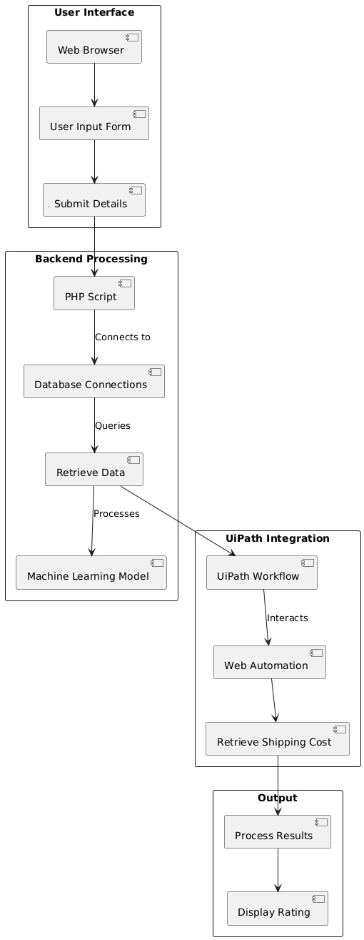
Architecture

Slide 9
System Requirements
Hardware
Processor:
Intel Core i3 or higher / AMD equivalent (Recommended: Intel Core i5 or i7 for optimal performance).
RAM:
Minimum: 4 GB
Recommended: 8 GB or higher for smoother multitasking and handling multiple automation workflows.
Storage:
Minimum: 256 GB Hard Drive
Recommended: 512 GB SSD or higher for faster read/write speeds.

Slide 10
Software
Operating System:
Windows 10 or higher (64-bit recommended).
Automation Tool:
UiPath Studio (Recommended version: 2023.10.4 or higher for the latest features and stability).
Browser:
Google Chrome, Mozilla Firefox, or Microsoft Edge (Ensure the required browser extensions for UiPath are installed).
UiPath Packages:
UiPath.UIAutomation.Activities: For web automation and interaction with the courier website.
UiPath.System.Activities: For core automation functionalities.
UiPath.WebAPI.Activities: (Optional) For API-based interactions with courier systems if integrated later.
Development Tools:
UiPath Studio Community/Enterprise Edition for creating automation workflow

Slide 11
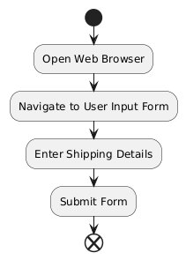
Functional Description
Module 1: User Input Collection
Short Description:
This module is responsible for gathering essential shipping details from the user. It collects inputs such as sender and recipient addresses, package weight, and dimensions through a user-friendly input dialog. The data is then passed to the automation system for further processing.

Slide 12
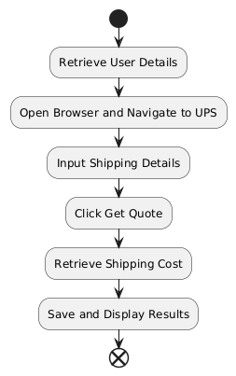
Functional Description
Module 2: Web Interaction
Short Description:
This module automates the interaction with the courier website (e.g., UPS). It inputs the collected shipping details into the website, handles dynamic dropdowns, and submits the information for processing the shipping quote.

Slide 13
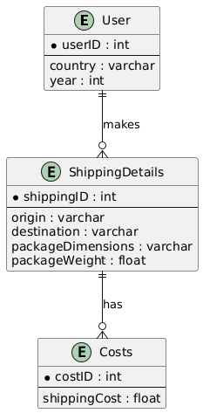
Entity-Relationship-Diagram

Slide 14
Process Design
Main Process: Shipping Cost Calculation Automation
Description:
The main process automates the workflow to calculate shipping costs by collecting user input, interacting with the courier website, retrieving quotes, and displaying the results.

Slide 15
Sub-Processes
Sub-Process 1: Collect User Input
Description:
Gather essential shipping details from the user, such as sender/recipient addresses, package weight, and dimensions.
Activities:
  Prompt user with an input dialog for required details.
  Validate the provided inputs.
  Store the inputs for further processing.

Slide 16
Sub-Process 2: Open Courier Website
Description:
Launch the courier’s website in a browser and prepare it for interaction.
Activities:
  Use the browser automation activity to navigate to the courier website (e.g., UPS).
  Wait until the page loads completely.

Slide 17
Sub-Process 3: Input Shipping Details
Description:
Enter the collected user data into the courier website’s form fields.
Activities:
  Input addresses (sender and recipient).
  Input package details (weight, dimensions).
  Handle dynamic dropdown suggestions if they appear.

Slide 18
Sub-Process 4: Submit Data and Retrieve Quote
Description:
Submit the form and wait for the website to calculate the shipping cost.
Activities:
  Click the "Get Quote" button on the website.
  Wait for the quote to load.

Slide 19
Sub-Process 5: Extract and Display Result
Description:
Retrieve the displayed shipping cost from the website and show it to the user.
Activities:
  Use data scraping or text extraction to capture the shipping cost.
  Display the cost to the user using a message box.

Slide 20
Implementation
Implementation of Module 1: Collect User Input
Use the Input Dialog activity to prompt the user for the following details:
    Sender Address
    Recipient Address
    Package Weight
    Package Dimensions (Length, Width, Height)
Implementation of Module 2: Web Interaction (Courier Website Automation)
  Use the Use Application/Browser activity to open the courier website in the default browser.
  Use Type Into activities to input the sender address, recipient address, weight, and dimensions into the respective fields on the website.
  Use the Click activity to submit the data by clicking the "Get Quote" button.
  Use Delay or Element Exists activities to ensure the website has loaded the result before proceeding to the next module.

Slide 21
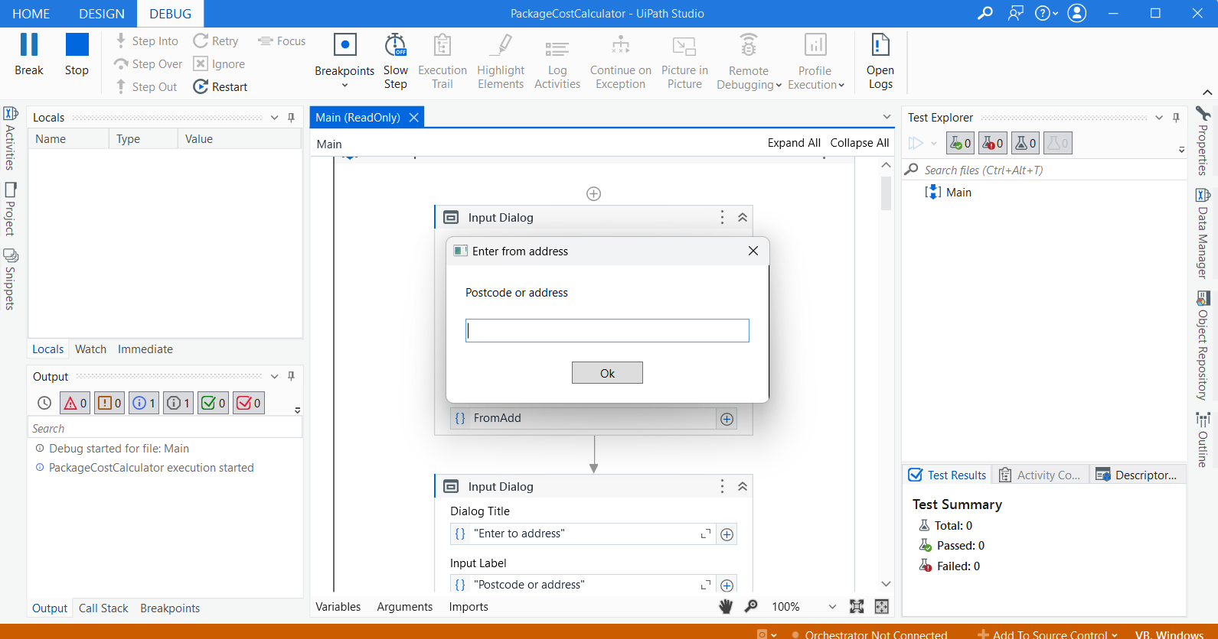
Screenshots

Slide 22
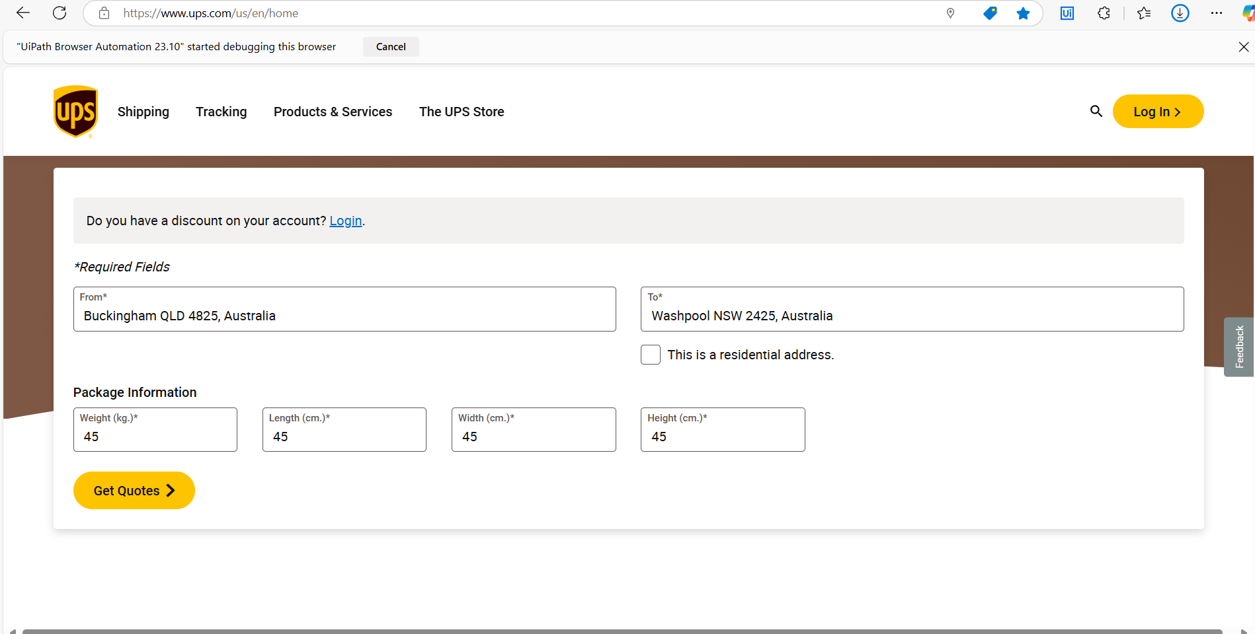

Slide 23
Testing
The automation solution has undergone rigorous testing to ensure its functionality, reliability, and accuracy. Each module was tested individually and in combination to validate seamless integration and optimal performance.
Unit Testing:
  Each module, including data collection and web interaction, was independently verified to ensure correct functionality. For example, the Input Dialog activity accurately captured and stored user inputs in the expected variables.
Integration Testing:
  The end-to-end workflow was tested to confirm that data collected in the input phase was accurately transmitted to the courier website. All steps worked cohesively without any data loss or mismanagement.
System Testing:
  The entire process was tested in real-world scenarios, using various input combinations. The system consistently retrieved accurate shipping quotes and displayed the results without any issues.

Slide 24
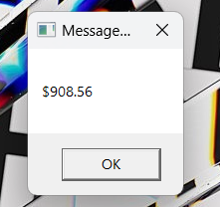
Screenshots

Slide 25
Conclusions
The automation project for shipping cost calculation has successfully streamlined the process of collecting user input, interacting with the courier website, and retrieving shipping quotes. Through rigorous testing and validation, the solution has proven to be accurate, reliable, and efficient in handling diverse scenarios, including error management and real-world data variations.
The developed solution serves as a scalable and adaptable framework, capable of integrating additional features or extending to other courier services, ensuring its long-term value and utility.

Slide 26
Future Enhancement
Integration with Multiple Courier Services:
Extend the automation to interact with additional courier websites, allowing users to compare quotes from multiple service providers in a single workflow.
Dynamic Data Validation:
Implement advanced validation mechanisms, such as integrating with APIs, to verify addresses, package dimensions, and weight before submission.
Data Storage and Reporting:
Store shipping request and quote data in a centralized database or generate detailed Excel reports for tracking and analysis over time.
User Interface Enhancement:
Develop a front-end interface for users to input details, review past shipping requests, and track ongoing transactions seamlessly.
Real-Time Tracking:
Extend the solution to retrieve tracking details for shipments once a quote is accepted and shipping is initiated.

Slide 27
IEEE Paper
Title
Authors

Slide 28
References
UiPath Documentation: https://docs.uipath.com
UiPath Forum: https://forum.uipath.com

Slide 29
Queries

Slide 30
Demonstration

Slide 31
Thank You

